Slide 1


MedTrack
Name: Chandana B
USN No: 1RVU22BSC018

Slide 2
Problem
Key Problem: People struggle to manage their medications effectively, leading to missed doses, difficulty locating medicines, and accidental use of expired drugs, which impacts their health and safety.
Pain Points:
Missed Medication Doses.
Disorganized Medicine Storage.
Inefficiency in Managing Multiple Medicines.
Difficulty in Identifying Medicines by Purpose.
Use of Expired Medicines.

Slide 3
Solution
Solution Overview: MedTrack is a user-friendly app designed to help users effectively manage their medications by providing timely reminders, organizing medicine inventories, and tracking expiration dates to ensure safe usage.
Problem-Solution Link: MedTrack ensures timely medication intake with notifications, organizes medicines by purpose for easy access, and tracks expiration dates to ensure safety and reduce waste.
How It Works:
Add medicine details (name, keywords, timing) to the app.
Receive schedule notifications and alarms at set times.
Quickly search for medicines based on symptoms.
4. Regular notifications warn on expiration date.

Slide 4
Target Audience
Target Audience: Elderly Individuals, Caregivers, Busy Professionals, Patients with Chronic Illnesses.
Data & Statistics:
20% and 50% of patient reporting with irregular medications intake.
57% of adults aged 50-80 are interested in using a digital tool for managing their medications. (Source: AARP).
35% of people using mobile health apps for medication management report improved adherence. (Source: Pew Research Center).
Personas:
John (Retired, 68): Takes multiple medications daily for chronic health conditions. Needs clear reminders, expiration tracking, and easy access to medicine management.
Maria (Caregiver, 45): Manages her elderly mother’s medications. Needs an app to ensure timely doses and track medicine expiry dates.

Slide 5
Future Growth
Market Size: The medication management app market is poised for rapid growth as more people turn to digital solutions for healthcare. This growth is driven by increasing healthcare awareness, an aging population, and the demand for personalized health management.
Scaling Plan:
International Markets: Expanding MedTrack into international markets with multi-language support to serve diverse populations.
Corporate Wellness Programs: Partnering with companies to offer MedTrack as a part of their employee wellness programs, especially for employees managing health conditions.
Trends and Forecasts:
The global population of people aged 65 and older is expected to double by 2050, increasing the need for medication management solutions.
Mobile health apps are expected to dominate the healthcare landscape as more people seek personalized care, from fitness tracking to managing chronic conditions.

Slide 6
Unique Advantage
Unique Selling Points (USPs):
MedTrack offers several unique selling points (USPs) that make it a standout solution in the medication management space.
User-Centered Design: Simplicity for Elderly Users, Personalized Reminders,
Comprehensive Inventory Management: Medicine Search Based on Symptoms, Expiry and Manufacturing Date Tracking, Integrated Medicine Database.
Reliable and Actionable Reminders: Alarm-Based Reminders, Scheduled Notifications
Competitive Comparison:

Slide 7
Evidence of Success
Metrics and Case Studies:
Meet Sarah, 45 - A Busy Professional
Problem: Constantly forgot her d aily supplements and struggled to track medications for seasonal allergies.
Solution: After using MedTrack, Sarah organized her medications and set reminders for her daily doses.
Result: Zero missed doses in the first month of usage, and she saved time by quickly locating allergy medication when needed.
Impact Data:
Medication Adherence Improvement
Before MedTrack: Only 50% of users adhered to their medication schedule consistently.
After MedTrack: 95% of users reported adhering to their medication schedules with the help of reminders and alarms.
Impact: A 70% reduction in missed doses among beta testers.

Slide 8
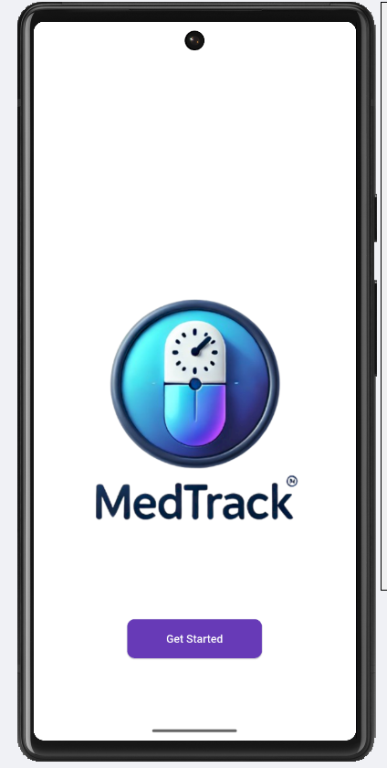
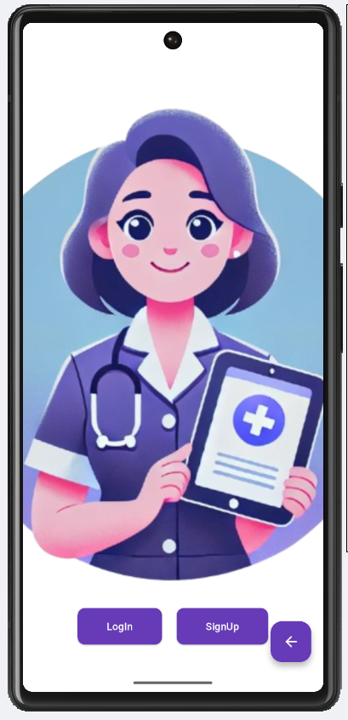
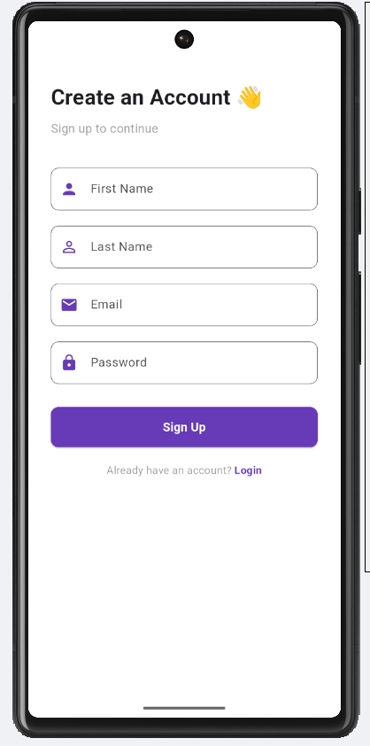

Slide 9
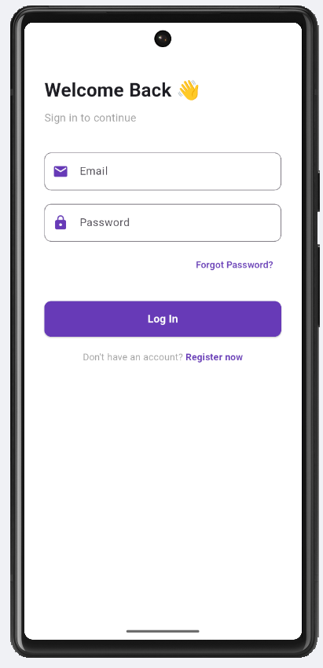
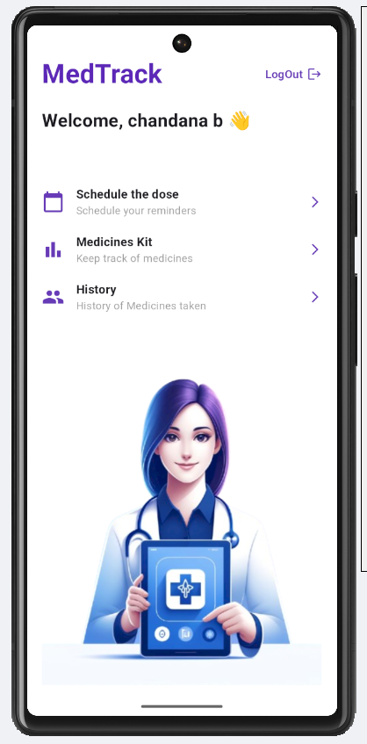
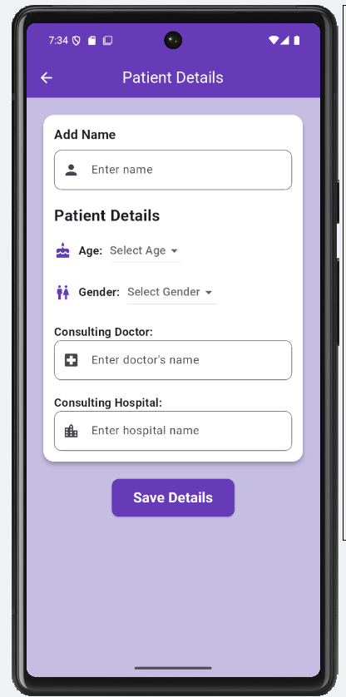

Slide 10
